Slide 1

The College Application:
An Insider’s View
www.admissions.umd.edu
ApplyMaryland@umd.edu
301.314.TERP (8377)
1.800.422.5867
Notes:
Introduction

Slide 2
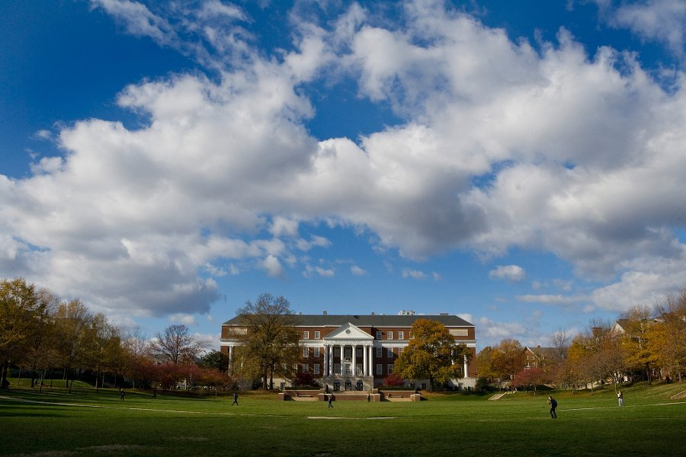
Types of Admission Applications
The Common Application
The Coalition Application
Individual Institution Applications
Notes:
Reminder: every school is different, should be looking into which schools have which type of applications

Slide 3

The Common Application
  The “Common App” is an organization serving students and institutions by providing an application which can be submitted to over 750 institutions who participate in the Common Application membership.
  The Common App thus helps provide access to higher education by allowing students to apply to multiple institutions with one application form.
Notes:
Reminder: Supplemental items

Slide 4
Pop Up Question!
How many institutions are part
of the Common Application?
Over 750!
Notes:
Reminder: Supplemental items

Slide 5
Individual Institution Application
  Some institutions have their own application for general admissions. Other institutions may have their own application for special programs, scholarships, or academic departments.

Slide 6

Coalition Application

Slide 7
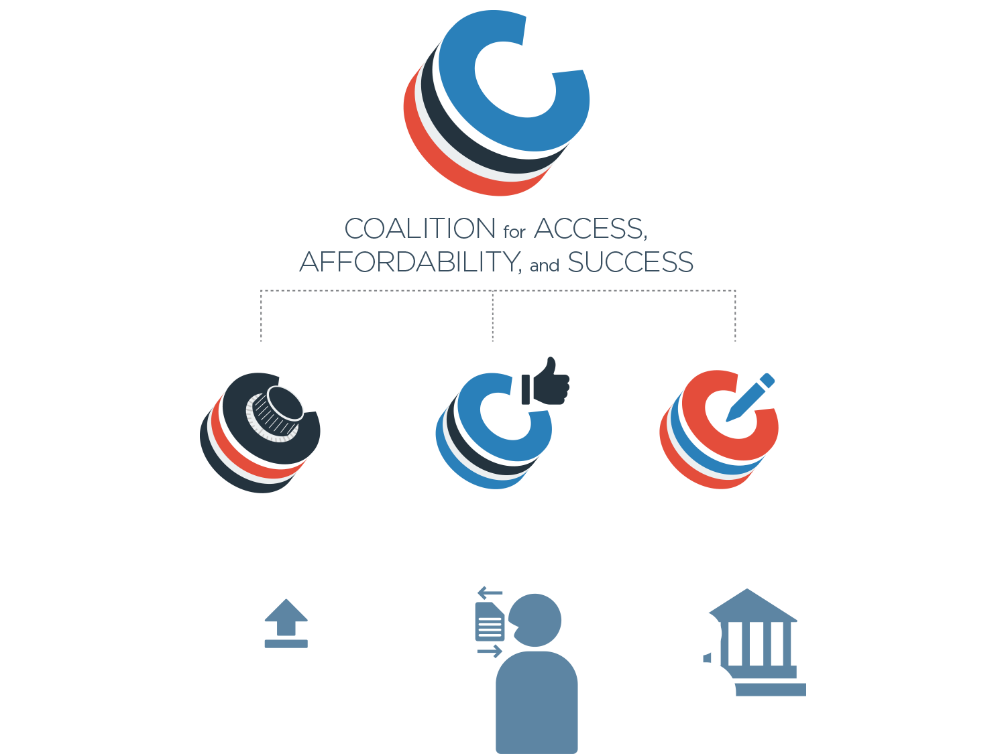
VIRTUAL
LOCKER
COLLABORATION
PLATFORM
APPLICATION PORTAL
Notes:
Make a free count
Over 140 institutions, UMCP being one of them, both public & private
Commitment to access, affordability & success
To be members we had to meet certain criteria, such as demonstrated need and tuition cost as well as different resources

Slide 8
Pop Up Question!
How many institutions are part
of the Coalition Application?
140!
Notes:
Reminder: Supplemental items

Slide 9

Affordability
Coalition schools represent a range of public schools with low-cost, in-state tuitions and private schools committed to meeting the full demonstrated need of all their admitted domestic students.

Slide 10
Coalition Benefits for Students and Families
A single platform to plan, build, organize, and refine a student’s application to a variety of excellent institutions.
Confidence that if admitted to any Coalition school, they will be offered a responsible financial aid package and have a strong likelihood of college success.
Coalition schools can be trusted to meet their committed to access and outcomes.

Slide 11
Coalition Benefits for Mentors & Counselors
Using the Platform
Free college planning tools to aid mentors and counselors in their work with students.
The Coalition represents schools that can be recommended on access, affordability, and success.
A single location for researching schools, organizing materials, and at the appropriate time applying to Coalition schools.

Slide 12
Coalition Benefits for Students
Central site for students to being the college search and planning process.
Online space for students to collect academic documents, record extracurricular activities, and log observations, reflections, and ideas.
Students can choose appropriate items from their Lockers to use in their applications to Coalition and non-Coalition schools.
Online platform for students to engage their support network (parents, mentors, counselors) to view items from their Locker and provide advice and guidance to the student.
One application platform allowing for application to a wide range of public and private colleges and universities from one site.

Slide 13
Pop Up Question!
Who benefits from using the Coalition?
Parents | Mentors
Counselors | STUDENTS

Slide 14
Components of the Application
Most colleges require several basic elements:
Application Form:
Demographic Information, Family Educational Background, Residency
Application Fee:
Are there waivers or exemptions available?
High School Transcripts
Letter(s) of Recommendation:
How many? From whom?
College Essay(s)
Test Scores:
SAT, SAT II, Subject Test, ACT, Test Optional
Activity Sheet or Resume
Short Answer Questions
Notes:
A “good” essay: tell us something we that we have not heard in your by looking at your transcript and possibly letters of recommendation. Do not repeat what is on the resume. Do not misspell words, use the wrong school, use bad language, or use big words outside of your normal vernacular.
Transcript(s)!!: Most updated and if you have switched schools, we need a transcript from those schools as well

Slide 15
Types of Review
Holistic and Committee Review
Data Driven
Open Enrollment

Slide 16
26 FACTORS
High school achievement
Grades in academic subjects
Progression of performance
Rank in class (actual or percentile)
Written expression of ideas (essays)
Gender
SAT I or ACT scores
Work experience
Extenuating circumstances
Recognition of special achievement
Socio-economic background
Breadth of life experiences
Extracurricular activities
Special talents and skills
Community involvement
Community service
Demonstrated leadership
Academic endeavors outside the classroom
Quality of coursework
Residency status
Race
Ethnicity
Family educational background
Learning differences
English as a second-language / Language spoken at home
Geographic origin

Slide 17
Application Deadlines
Understanding the types of deadlines:
Early Decision
  Binding contract.
Early Action
  Non-binding, but still provides benefits of applying early.
Priority
  Non-binding, priority consideration for merit scholarships, special programs, & admissions.
  UMD uses a priority deadline (November 1st)!
Regular Decision
  Final deadline. No special benefits or extra consideration.
Rolling
  No fixed deadline, notifications come depending on school policies.

Slide 18
Meeting Application Deadlines
Meeting an application deadline means submitting ALL of the required documents by the stated date—not just the application form
Most institutions will accept documents as meeting the deadline as long as they are postmarked by the required date
Submitting applications and documents early is the best way to be sure that they are meeting the deadline
Although many early deadlines are not until November or December, most institutions begin accepting applications as early as August or September!

Slide 19
Checking Your Application Status
What is the next step after submitting your application?
Checking its status!
Checking on your application status is just as important as meeting an application deadline
Checking your status allows you to verify that all of your submitted materials have been received
Most institutions offer several options to check on your application’s status
Notes:
Why its important: You never know what might happen—mail could get lost, your teacher could forget to send their recommendation letter, your electronic transcript could fail to download
Verifying:
Some institutions will notify you of missing items or a complete application, but some will not
Just like you had a checklist for the application materials, you want to have a checklist for verifying the receipt of your documents at the admissions offices
Options:
Call the admissions office and inquire about your file
Email the admissions office and inquire about your file
Use an online document tracker or application tracker which is automatically updated as materials are received

Slide 20
Pop Up Question!
What are three ways you can check your application status?
Email | Call | Tracker

Slide 21
Admissions Decisions
Understanding the types of decisions:
Fall
  Admitted for Fall Term
Spring
  Admitted for Spring Term; Freshman Abroad, Freshman Connection, Community College
Waitlisted
  From Spring to Fall
Denied
  Not offered admission

Slide 22
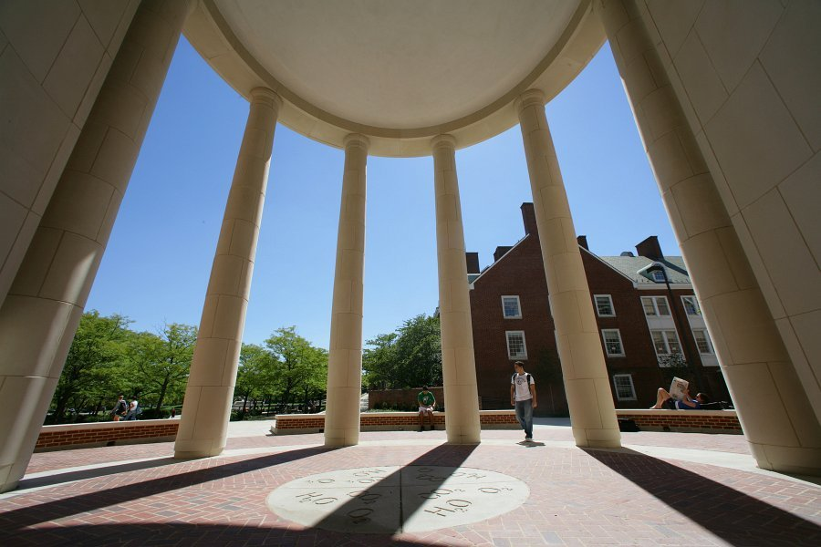
I’ve completed my applications. Now what?
Relax!
Send any important updates to the schools where you applied (ex. mid-year grades, new awards or achievements)
Check your email. Some decisions may be released electronically. If your email changes, make sure you’ve notified all the schools where you applied.
Have patience!
Notes:
Relax! The hard part is over. Enjoy your new free time by catching up on school work or spending time with family and friends.
Use email that was on application
If you do not hav a professional email address, CHANGE IT..create a new one

Slide 23
Examples of UMD Applicants
What do you think was the decision of these applicants?
Student A
  4.1
  1500 New SAT
  President of Red Cross Club, National Math Honor Society, Salvation Army Club & Anime Club and involved in several other extracurricular activities
Notes:
Student A- As, Bs, and Honors, extensive resume- Admitted
Student B- Upward trend, lower grades early in career, and super involved -- Admitted
Student C- Downward trend with Cs later in career, Resume not that lengthy just those words- Not offered admission

Slide 24
Examples of UMD Applicants
What do you think was the decision of these applicants?
Student B
  3.9
  29 (1380 New SAT)
  1 C freshman year
  3 sport athlete, Girl Scout, involved in several religious groups, SADD, Executive SGA representative, went on mission trips, mentor, many hours of community service
Notes:
Student A- As, Bs, and Honors, extensive resume- Admitted
Student B- Upward trend, lower grades early in career, and super involved -- Admitted
Student C- Downward trend with Cs later in career, Resume not that lengthy just those words- Not offered admission

Slide 25
Examples of UMD Applicants
What do you think was the decision of these applicants?
Student C
  4.19
  2 C's junior year
  1300 New SAT
  Participated in a food drive for two years, multiple honor roll awards and multiple attendance awards
Notes:
Student A- As, Bs, and Honors, extensive resume- Admitted
Student B- Upward trend, lower grades early in career, and super involved -- Admitted
Student C- Downward trend with Cs later in career, Resume not that lengthy just those awards- Not offered admission

Slide 26
Helpful Hints
Most institutions post their updated application each year around August 1st—it’s never too early to get started!
Don’t be afraid to ask for help!
    Have a teacher, friend, or parent proof-read your essay or résumé
Make sure you give your guidance counselor, teacher, or coach plenty of time to write your recommendation letter.
  Remember, they probably have other students asking, too!
  At least two weeks is appreciated, three-four weeks if possible.

Slide 27
Good luck with your applications!
Questions?

