Slide 1

The College Application:
An Insider’s View
www.admissions.umd.edu
ApplyMaryland@umd.edu
301.314.8385
1.800.422.5867

Slide 2
Components of the Application
Most colleges require several basic elements:
Application Form:
Online versus paper?
Application Fee:
Are there waivers or exemptions available?
High School Transcripts
Test Scores:
SAT or ACT?
Are subject tests required?
Activity Sheet or Resume
College Essay(s)
Letter(s) of Recommendation:
How many? From whom?

Slide 3

Additional Components
Some colleges may also require supplemental items:
Portfolio:
If applying to an art or architecture major
Short Answer Questions
Separate applications to special programs:
Honors programs, special residential groups, etc.
Separate applications for scholarship consideration:
Departmental Scholarships, alumni scholarships, etc.
* UMD does not require separate applications for special programs or merit-based scholarships, but you must apply by the November 1 priority deadline for consideration.

Slide 4
Application Deadlines
Understanding the types of deadlines:
Early Decision
Binding contract
Early Action
Priority
Non-binding, but still provides benefits of applying early
Regular Decision
Rolling
Non-binding, but still provides benefits of applying early
UMD uses a priority deadline (November 1st)!
Final deadline. No special benefits or extra consideration.
No fixed deadline, notifications come depending on school policies.

Slide 5
Meeting Application Deadlines
Meeting an application deadline means submitting ALL of the required documents by the stated date—not just the application form
Most institutions will accept documents as meeting the deadline as long as they are postmarked by the required date
Submitting applications and documents early is the best way to be sure that they are meeting the deadline
Although many early deadlines are not until November or December, most institutions begin accepting applications as early as August or September!

Slide 6
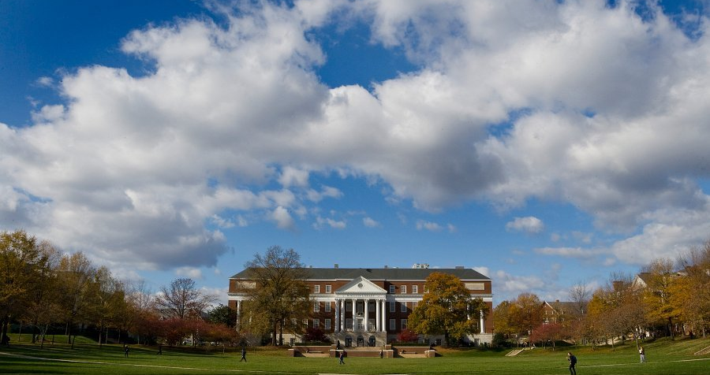
Types of Admission Applications
The Coalition Application
*New*
Individual Institution Applications
The Common Application

Slide 7
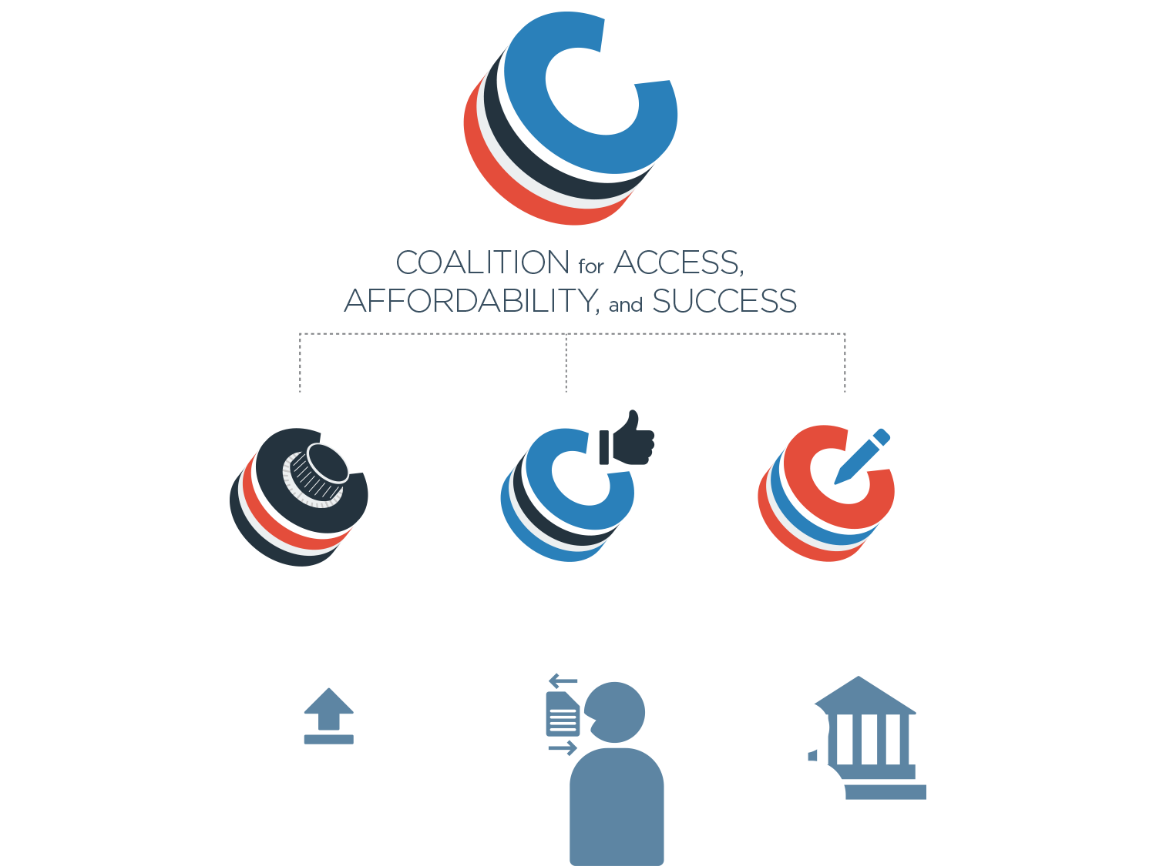
VIRTUAL
LOCKER
COLLABORATION
PLATFORM
APPLICATION PORTAL

Slide 8
Coalition Benefits for Students and Families
A single platform to plan, build, organize, and refine a student’s application to a variety of excellent institutions.
Confidence that if admitted to any Coalition school, they will be offered a responsible financial aid package and have a strong likelihood of college success
Coalition schools can be trusted to meet their commitment to access and outcomes.
Responsive and adaptive application design allows students and families to engage through any computer, tablet, or mobile device

Slide 9

The Common Application
  The “Common App” is an organization serving students and institutions by providing an application which can be submitting to over 400 institutions who participate in the Common Application membership
  The Common App thus helps provide access to higher education by allowing students to apply to multiple institutions with one application form

Slide 10
Individual Institution Application
  Some institutions do not participate in the Common Application, and have their own application form that must be submitted
  Most institutions who have their own application offer both a paper and an online version, so students have a choice of submitting the form online or submitting a paper copy through the mail

Slide 11
Checking Your Application Status
What is the next step after submitting your application?
Checking its status!
Checking on your application status is just as important as meeting an application deadline!
Checking your status allows you to verify that all of your submitted materials have been received
Most institutions offer several options to check on your application’s status
Notes:
Why its important: You never know what might happen—mail could get lost, your teacher could forget to send their recommendation letter, your electronic transcript could fail to download
Verifying:
Some institutions will notify you of missing items or a complete application, but some will not
Just like you had a checklist for the application materials, you want to have a checklist for verifying the receipt of your documents at the admissions offices
Options:
Call the admissions office and inquire about your file
Email the admissions office and inquire about your file
Use an online document tracker or application tracker which is automatically updated as materials are received

Slide 12
Helpful Hints
Most institutions post their updated application each year around August 1st—it’s never too early to get started!
Don’t be afraid to ask for help!
    Have a teacher, friend, or parent proof-read your essay or résumé
Make sure you give your guidance counselor, teacher, or coach plenty of time to write your recommendation letter.
  Remember, they probably have other students asking, too!
  At least two weeks is appreciated, three-four weeks if possible.

Slide 13
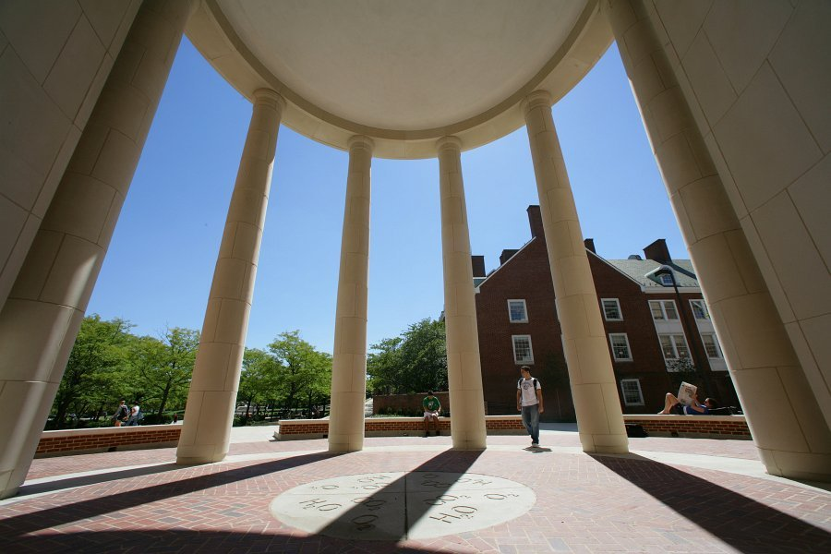
I’ve completed my applications. Now what?
Relax!
Send any important updates to the schools where you applied (ex. mid-year grades, new awards or achievements)
Have patience!
Check your email. Some decisions may be released electronically. If your email changes, make sure you’ve notified all the schools where you applied.
Notes:
Relax! The hard part is over. Enjoy your new free time by catching up on school work or spending time with family and friends.

Slide 14
Good luck with your applications!
Questions?

Slide 15
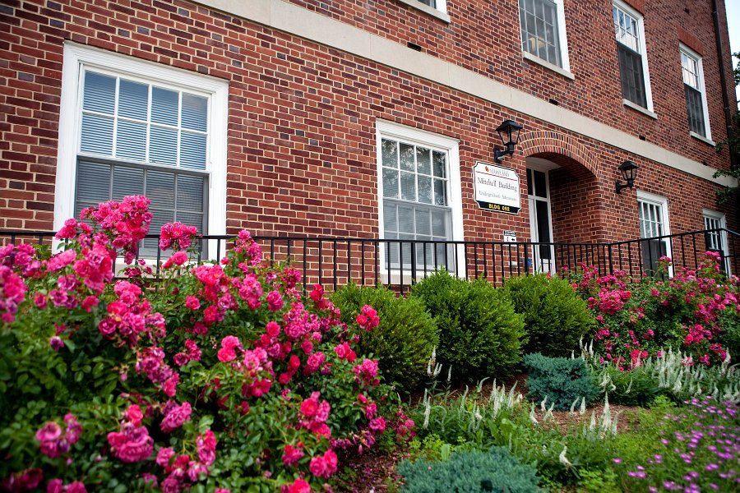
Contact Info
Office of Undergraduate Admissions
College Park, MD 20742
ApplyMaryland@umd.edu
301-314-8385/ 1-800-422-5867
www.admissions.umd.edu

Slide 16


