Slide 1
College Application Process
Reservoir High School

Slide 2
Overview
Research school
The Right Fit
Campus Tours
Create an application profile
Send Scores to prospective schools
Additional Info

Slide 3
Where do I Start?
College Board “Big Future”
Princeton Review

Slide 4
Create a list of schools that fit your academic, financially profile.

Slide 5
Things to consider
I know
Need to know
Grades
Scores (ie. SAT and ACT)
Cost
Personality
Values/beliefs
Potential Major
Majors offered
Graduation Rate
Student/Staff Ratio
Cost
Location
Diversity
Clubs/Activities
Campus Safety
Career Services
Additional info

Slide 6
Create a Spreadsheet

Slide 7
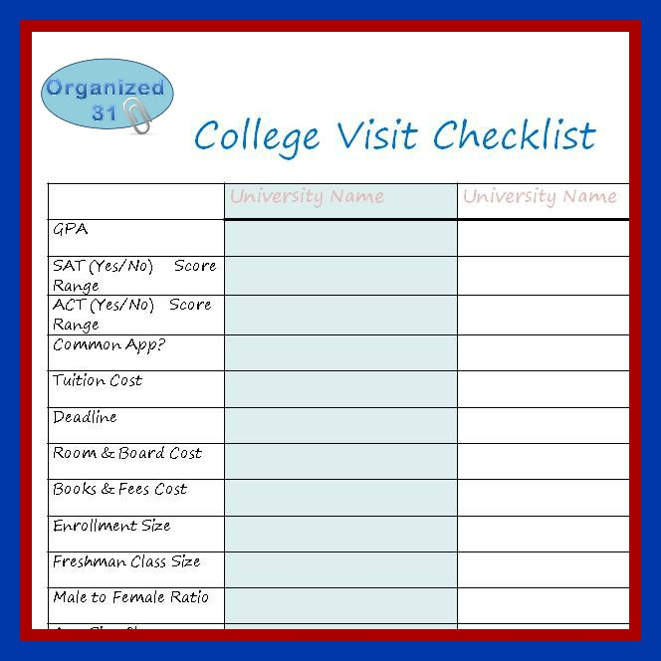
Spreadsheet items
List Potential Schools
Location
Cost to attend
Retention/Graduation Rate
School size
Application Fee
Do they…
Offer intended major
Offer clubs/organizations
Take notes

Slide 8
Arrange a campus tour.

Slide 9
Discuss your findings/tour experience with your family.

Slide 10
Make an appt. to meet with your (child’s) school counselor

Slide 11
Take the SAT’s/ACT’s
SAT’s
ACT
Test Date
Aug. 25. (deadline Jul. 27, 2018)
Oct. 6 (deadline Sept. 7, 2018)
Nov. 3. (deadline Oct. 5, 2018)
Fees
$47.50 no essay
$64.50 W/ essay
Test Date
Sept. 8, 2018 (deadline Aug 10, 2018)
Oct. 27, 2018 (deadline Sept. 28, 2018)
Fees
$46.00 no essay
$62.50 w/essay

Slide 12
College Application Process

Slide 14
Several Ways to apply
Common Application
The Coalition
The Common Black College Application
More than 750 schools use this service.
Approximately 100 schools use this service.
Approximately 53 schools use this Service

Slide 15
Several Ways to apply
The Actual College/University

Slide 16
Application Components
Demographics
Year of entry at college/university
Affirmations
How to receive information
Affirming that you are over 13.
Name, Address, Geographic
Complete the education portion (priority)
Self report course history/grades, clubs
Key Information
Add School
Sign FERPA
School/Community Involvement
Essay for university
Supplemental Essay
(Some Schools require)
Some Schools require short essay on a variety of topics.

Slide 17
Send SAT and/or ACT Scores
The Counselor will not send your scores, it is your responsibility.

Slide 18
Required Forms
Waivers of Rights
Transcript Request
Naviance Surveys
Needs to be complete and turned in ASAP
Needs to be complete and turned in to students services 20 days prior to your 1st deadline.
You can complete more than one form
Need to be complete prior to the start of school.

Slide 19
October 1, 2018

Slide 20
Additional Information
Midyear grades (1st, 2nd, and midterm) to all schools you mentioned on your transcripts request form
Final transcript to the school, that you plan to attend in the Fall
Know that we will send your…

