Slide 2
Questions that we will answer in this presentation
How much does college cost, and what is included in the total cost?
What is the difference between grants, scholarships, loans, and work-study?
How does a student receive financial aid?

Slide 4
More than half of all students attending college in the United States receive some form of financial assistance.

Slide 6
NET PRICE
NET PRICE is the amount that a student pays to attend an institution in a single academic year AFTER subtracting scholarships and grants the student receives.
Focus on the NET PRICE.
Not the STICKER Price.

Slide 7
NET PRICE CALCULATORS

Slide 8
NET PRICE CALCULATORS
Available on a college’s website, net price calculators can help prospective students get a better handle on what they will be expected to pay.
Students enter information about their family’s financial situation to learn what similar students paid to attend the institution in the previous year.

Slide 9
WHY ARE NET PRICE CALCULATORS IMPORTANT?
Knowing your net price:
Gives you the best idea of what you’ll pay for a particular college
Makes comparing colleges easier
Widens your choice of colleges

Slide 10
NET PRICE CALCULATOR TIPS
Answer questions accurately
Remember that this is just an estimate and the actual cost may end up being higher or lower than the estimate provided by the net price calculator

Slide 12
The Financial Aid Process
FAFSA (Free Application for Federal Student Aid) – www.fafsa.ed.gov
CSS Profile – profileonline.collegeboard.com
Institutional aid applications
Be sure to check each individual school’s website to find out what forms are required and when they must be filed.

Slide 13
File Your FAFSA
Each year, the federal government awards roughly $150 billion to college students through need-based grants, loans, and work-study funds.
Filing the FAFSA ensures you are in the running.
It is required.
Watch deadlines.
Be organized.

Slide 14
an important day
October 1 is the first day that the FAFSA can be completed.

Slide 15
Federal Student Aid
Completing the FAFSA is the first step in securing federal aid for college, career school, or graduate school.
studentaid.ed.gov/sa/fafsa.ed.gov

Slide 16
CSS/ Financial Aid PROFILE
The PROFILE is a tool created by the College Board that allows students to complete one form and apply online for non-federal financial aid from almost 400 colleges, universities, professional schools, and scholarship programs.
https://student.collegeboard.org/css-financial-aid-profile

Slide 17
CSS/ Financial Aid PROFILE Tips
Available on October 1st
Use your College Board Account to complete the Financial Aid PROFILE
May be required by some colleges and universities
CSS / Financial Aid PROFILE is in addition to the FAFSA.

Slide 18
Be Smart About Scholarships
Thousands of scholarships exist. Some colleges automatically consider all applicants for scholarships. Other scholarships from colleges, universities, and private sources require special applications and additional work and motivation to make it happen.
Never pay money to apply to an outside scholarship.

Slide 19
Take Steps to Minimize Debt
The majority of students use loans to help finance their college education.
Don’t borrow any more than you absolutely need.

Slide 20
How Much Will it Cost?
Billable Costs
Tuition and Fees
On-Campus Room and Board
These costs will show up on the college bill.
Indirect Costs
Books and Supplies
Off-Campus Room & Board
Personal Expenses
Travel Costs
These costs do not show up on the college bill.

Slide 21
Assessing Student Need
A student’s financial need is calculated as the difference between the cost of attending the school, the Cost of Attendance (COA) minus any expected financial assistance (EFA), such as gifts or outside scholarships,
and the amount the student and their family is expected to pay, the Expected Family Contribution (EFC)
COA – EFC = Student Financial Need

Slide 22
Expected Family Contribution (EFC) is influenced by these factors:
The amount the student’s parents will be asked to pay from income and assets
The amount the student can contribute from earnings and savings
Family size, age of oldest parent, number of children currently attending college
Special circumstances: Health related expenses, loss of property or death in the family

Slide 24
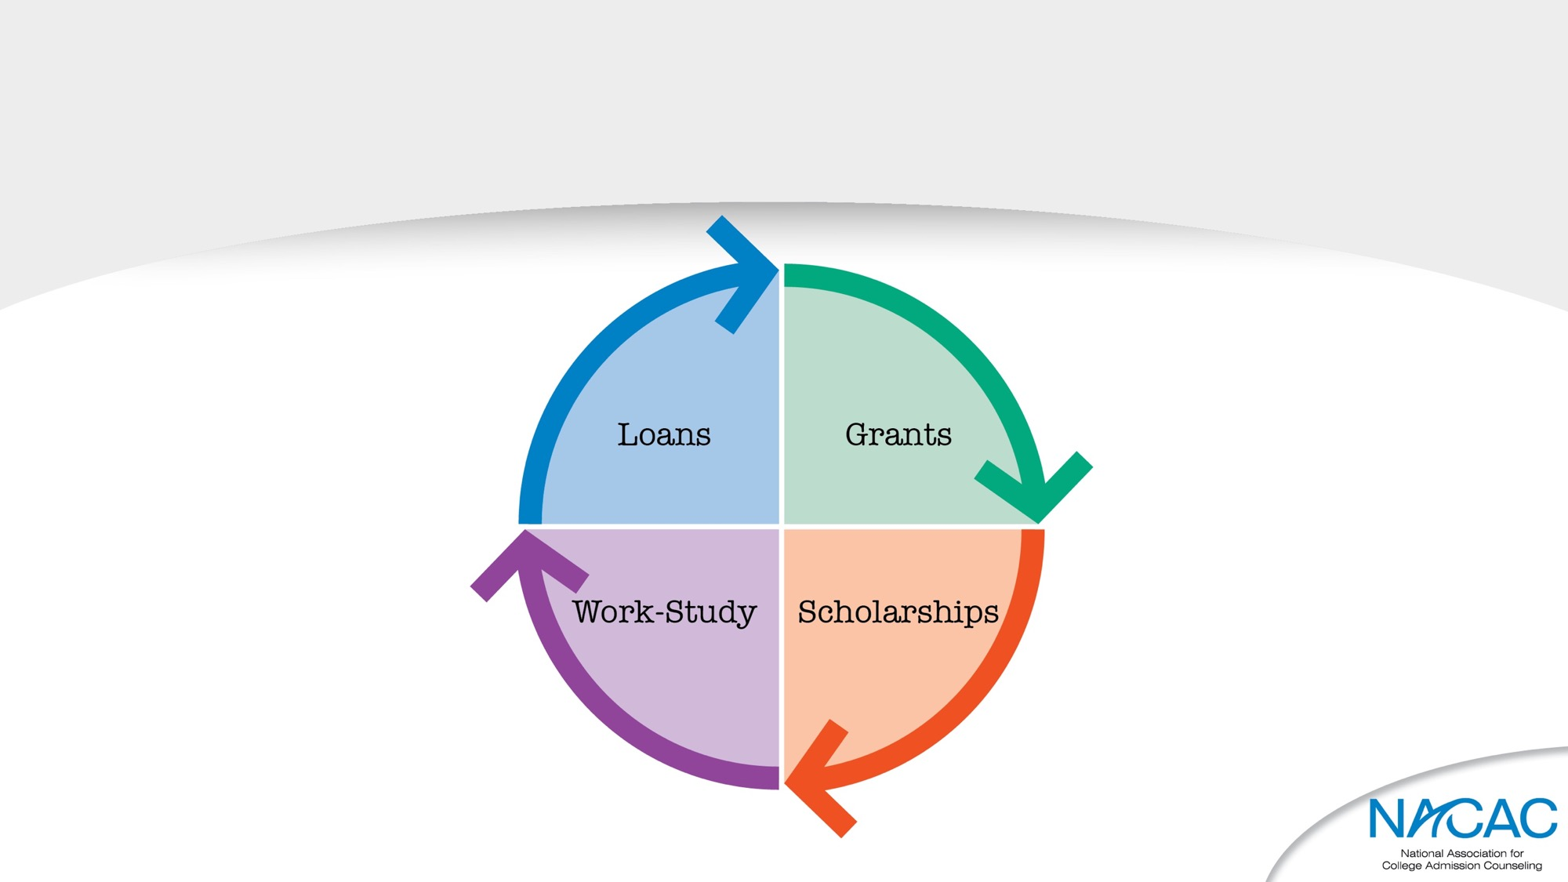
Types of financial aid

Slide 25
grants
Federal Pell Grants
Federal Supplemental Education Opportunity Grants (FSEOG)
State Grants
Institutional Grants

Slide 26
Scholarships
Athletic, Academic, Leadership, Theatre, Music
Usually Competitive
Institutional
National
State, Local, or Civic

Slide 27
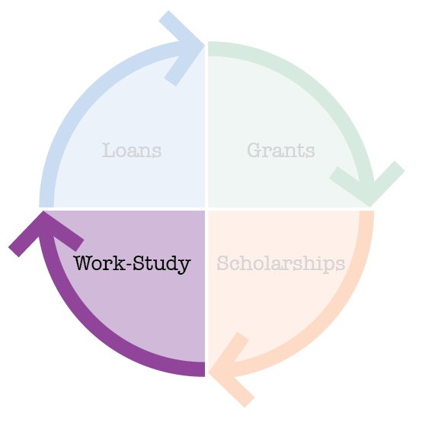
Work-study
Based on demonstrated need
Student is provided an on-campus job
10 – 15 hours per week and paid directly to student
Generally above minimum wage

Slide 28
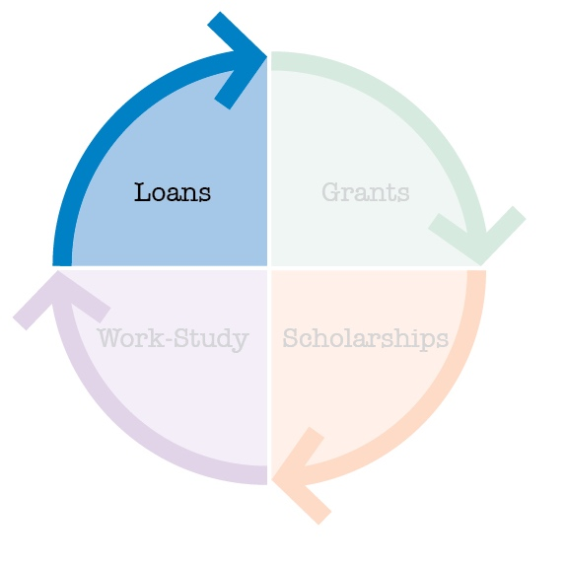
loans
Direct Subsidized & Unsubsidized
Perkins
PLUS (Parent Loan for Undergraduate Students)
Private Loans

Slide 30
Trusted Sources
Hundreds of websites purport to offer families advice about financial aid. Not all of them are truly helpful. Not all are accurate. NACAC has curated a list of trusted, up-to-date sources to help families navigate the process.

Slide 31
The Department of Education
Financial Aid Toolkit
2017 – 18 Counselors & Mentors Handbook
The National Training for Counselors & Mentors
Helping Students Navigate the Path to College
Federal Student Aid (FSA) Website

Slide 32
The Institute for College Access & Success
Income-Based Repayment
College InSight
uAspire Handout & Presentation
Project on Student Debt

Slide 33
National Association of Student Financial Aid Administrators (NASFAA)
College Affordability & Transparency Resources for Counselors
Student Aid Tips for Unique Populations

Slide 34
Consumer Financial Protection Bureau
Paying for College

Slide 35
National College Access Network
Form Your Future Campaign

Slide 36
Closing THOUGHTs
Planning how to finance a degree has become a more prominent part of the college application process. By becoming aware of the costs associated with college, your family is better positioned to incorporate educational costs into your savings plan.

Slide 38
We Want to hear from you!
Thank you for taking the time to download and share this presentation.
Your feedback is very important to us.
Please take a few minutes to complete our survey. Your responses will help us improve this PowerPoint presentation.

