Slide 1
Welcome to Reservoir High School
Student Services Edition

Slide 2
Our Goals for today
What is Student Services
How can Student Services support me as a student
Who should I know?
Naviance
What are my options?
Scenarios

Slide 3
Take a couple minutes to discuss w/ a partner…
What is Student Services?

Slide 4
Who/What is Student Services?
There are a team of people that consist of the following people:
School Counselors
School Psychologist
Social Worker
Registrar
Pupil Personnel Worker
Nurse
These people provide a WIDE range of services.
Our goal is to expose and prepare you for the opportunities after high school. In addition we will provide you with strategies to help you deal with life challenges.

Slide 5
We support your…
Academic Goals
Personal/Social Needs
Future Career Aspirations

Slide 6
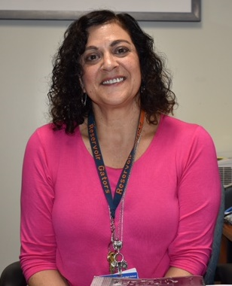
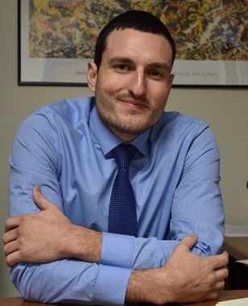
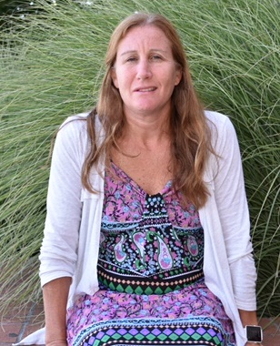
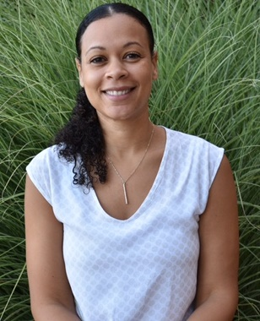
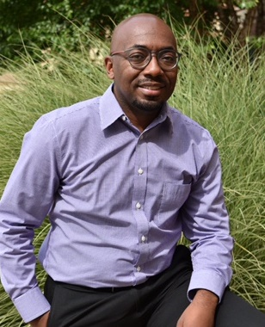
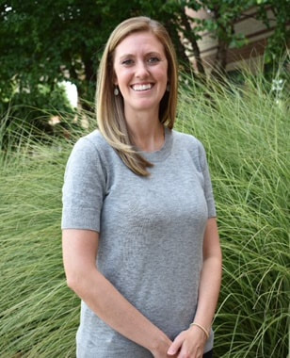
Ms. Packman
(A-B)
Mr. Drnec
(GM-K)
Ms. Altshuler
(P-Sm)
RHS School Counselors
Ms. Thurmon
(C-GL)
Ms. Beil
(L-O)
Mr. White
(Sn-Z)
Follow us on:
@Resi_Counselors

Slide 7
Pieces to the team
ADDITIONAL PEOPLE THAT YOU SHOULD KNOW
Ms. Charlie Secretary
Ms. Miles Data Clerk
Ms. Mandile Registrar
Ms. Metzler Registrar
Ms. Morales Hispanic Student Achievement Liaison
Ms. Olney Black Student Achievement Liaison
Ms. Tang School Cluster Nurse
Ms. Parish School Health Asst.
Ms. Kreitzer School Psychologist
Ms. Martin School Psychologist
Mr. Smith School Counselor (Intern)

Slide 8
How do I meet with my counselor or another member of the team?
Student Services is located in between the Front Office and the Atrium:
To make an appointment:
See Ms. Charlie (Front Desk)
BEFORE, AFTER SCHOOL, or DURING LUNCH
Email your counselor
Call Student Services
Once you make the appointment, you will receive a pass in your class to come visit your counselor.

Slide 9
In small group discuss…
What are some common challenges that students face in high school?
What are some resources students can use to help overcome these possible challenges?

Slide 10
Naviance Task
Go to rhs.hcpss.org
Hover over Student Services
Click on Student Services
Click on Naviance
Sign into Naviance using your student id and password-
(then click CLEVER to sign-in)
Click on the “About Me” tab
then “My Account”
click on the pencil icon to update your email address

Slide 11
What are my options after high school?
With a Partner
Find someone that you have something in common with related to clothing (ie. similar shirt pattern, same shoes, color in pants)
Discuss and create a list of the pros and cons to the following options after high school:
Attending a 4yr. university
Pursuing an apprenticeship
Joining the Armed forces
Attending a 2yr community college
Working
Going to a vocational/trade school
Come up with 2 pros and 2 cons for each item.
If you do not know what an option means, please skip over it.
If you are unsure of what one of these are, please do some research online.

Slide 12
Large image slide
Potential Challenges #1
Ryan is a 12th grade student at Reservoir High School that is interested in pursuing a 4yr college degree. Unfortunately, Ryan is aware that college is extremely expensive and unsure if his parent can afford to send him.
Is Ryan’s dream to attend a 4yr university, impossible? Why or why not?
What could Ryan do to reach his goal?
What resources could Ryan utilize?

Slide 13
Potential Challenge #2
Sally failed several courses during her first year of high school. Her GPA is a 1.75. She would like to be a mechanic and work on cars in the future. Sally does not think that her career path is still an option due to her academic performance during her first year.
Who could she go to for help? Why did you choose that person?
What programs are offered in Howard County to help Sally to reach her career goal?
Is it necessary to attend a college/university to become a mechanic? Why or Why not?

Slide 14
Potential Challenge #3
Trevor has dreamed of becoming a neurosurgeon in the future. He is unsure about what courses he should take to prepare him for a college/university. Trevor would like to attend Stanford once he graduates.
What courses do you think will help him reach his goal?
What resources are available to assist Trevor with his planning?
Is it necessary for Trevor to fill his schedule with AP/GT courses each year? Why or Why not?
Is it necessary for Trevor to attend an Ivy league university to reach his dream?

Slide 15
Thank you and Good Luck this year

