Slide 1
APPLICATION PROCESS
COLLEGE WORKSHOP
AUGUST 7TH, 2019

Slide 2
GOALS OF WORKSHOP
To understand how to request a letter of recommendation from counselors and teachers.
To provide an overview of how to use the Common App and other electronic applications.
To provide strategies and input on the admissions process.
To understand how Naviance can help students with the college application process.

Slide 3
STEP 1
THE COUNSELOR PART

Slide 4
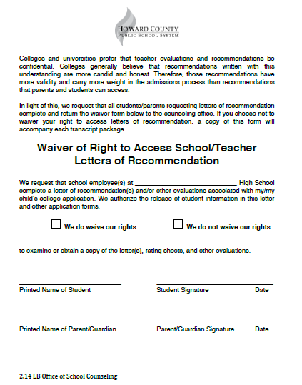
Waiver of Rights:
This form must be completed once by all students wishing to send transcripts to college.
Complete and return to Student Services.

Slide 5
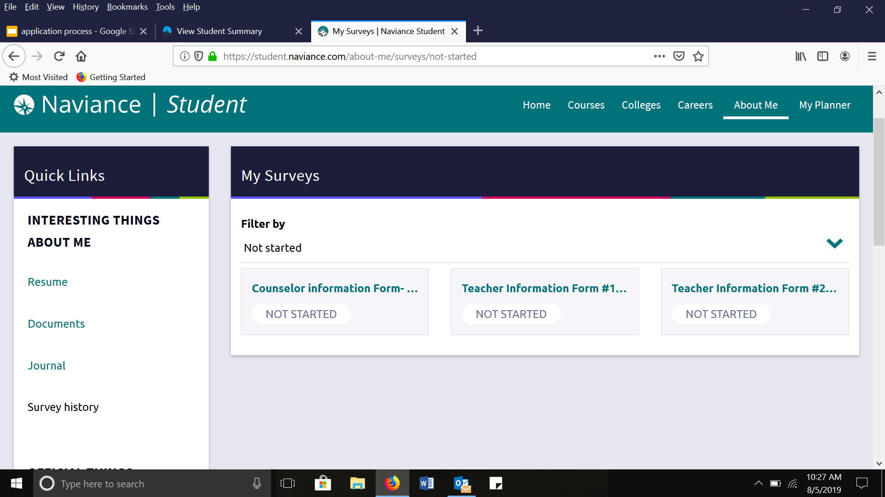
Answer with great DETAIL!!

Slide 6
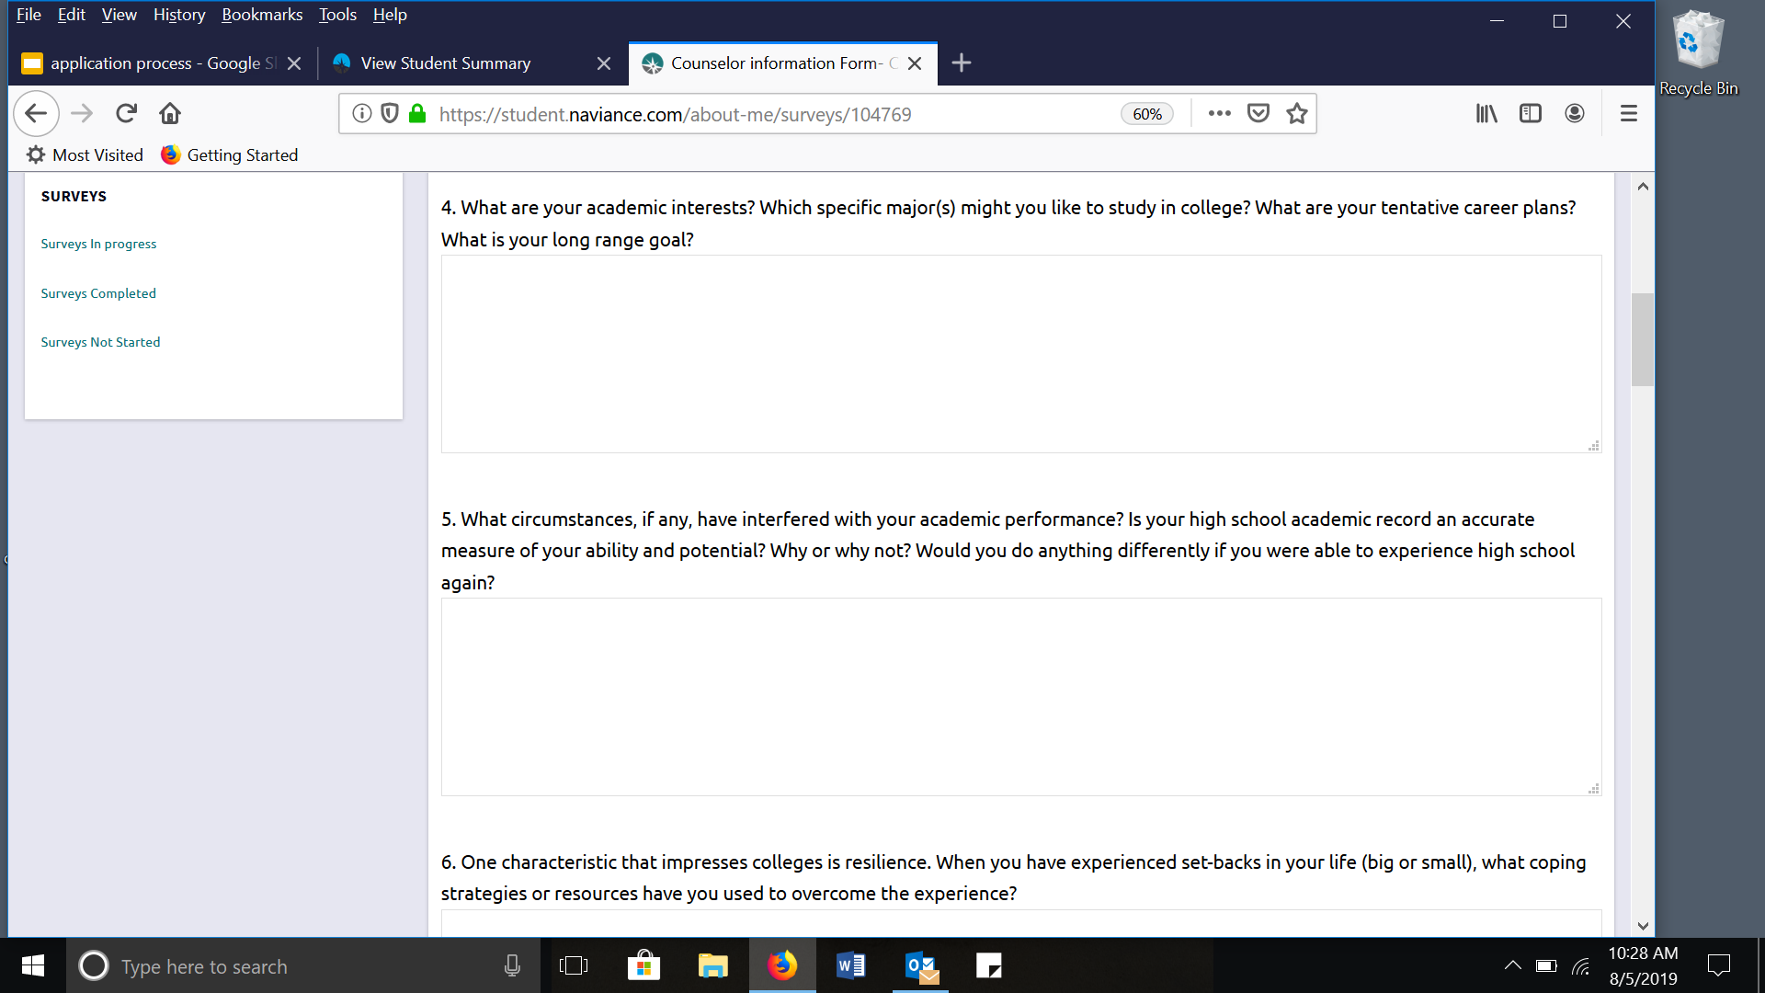

Slide 7
Transcript Request Form
Return to Student Services by Oct 2 for November 1 college deadline!
First 3 transcripts are free and the rest are $2.

Slide 8
ELECTRONIC SUBMISSION: WHAT GETS SENT?
A certified copy of your high school transcript which includes your current schedule
High School Profile
Letter of recommendation from counselor and teacher (if requested)
Note:
1. Official transcripts CANNOT be released until the first week in October.
2. Midterm grade reports will be sent for all students to all schools included on your transcript request form.

Slide 9
STEP 2
THE TEACHER PART

Slide 10
ASK TEACHERS FOR LETTERS
Personally Ask Two Teachers to Write your Letter of Recommendation
**It is imperative that you ask the teachers face to face or send them an email requesting this**

Slide 11
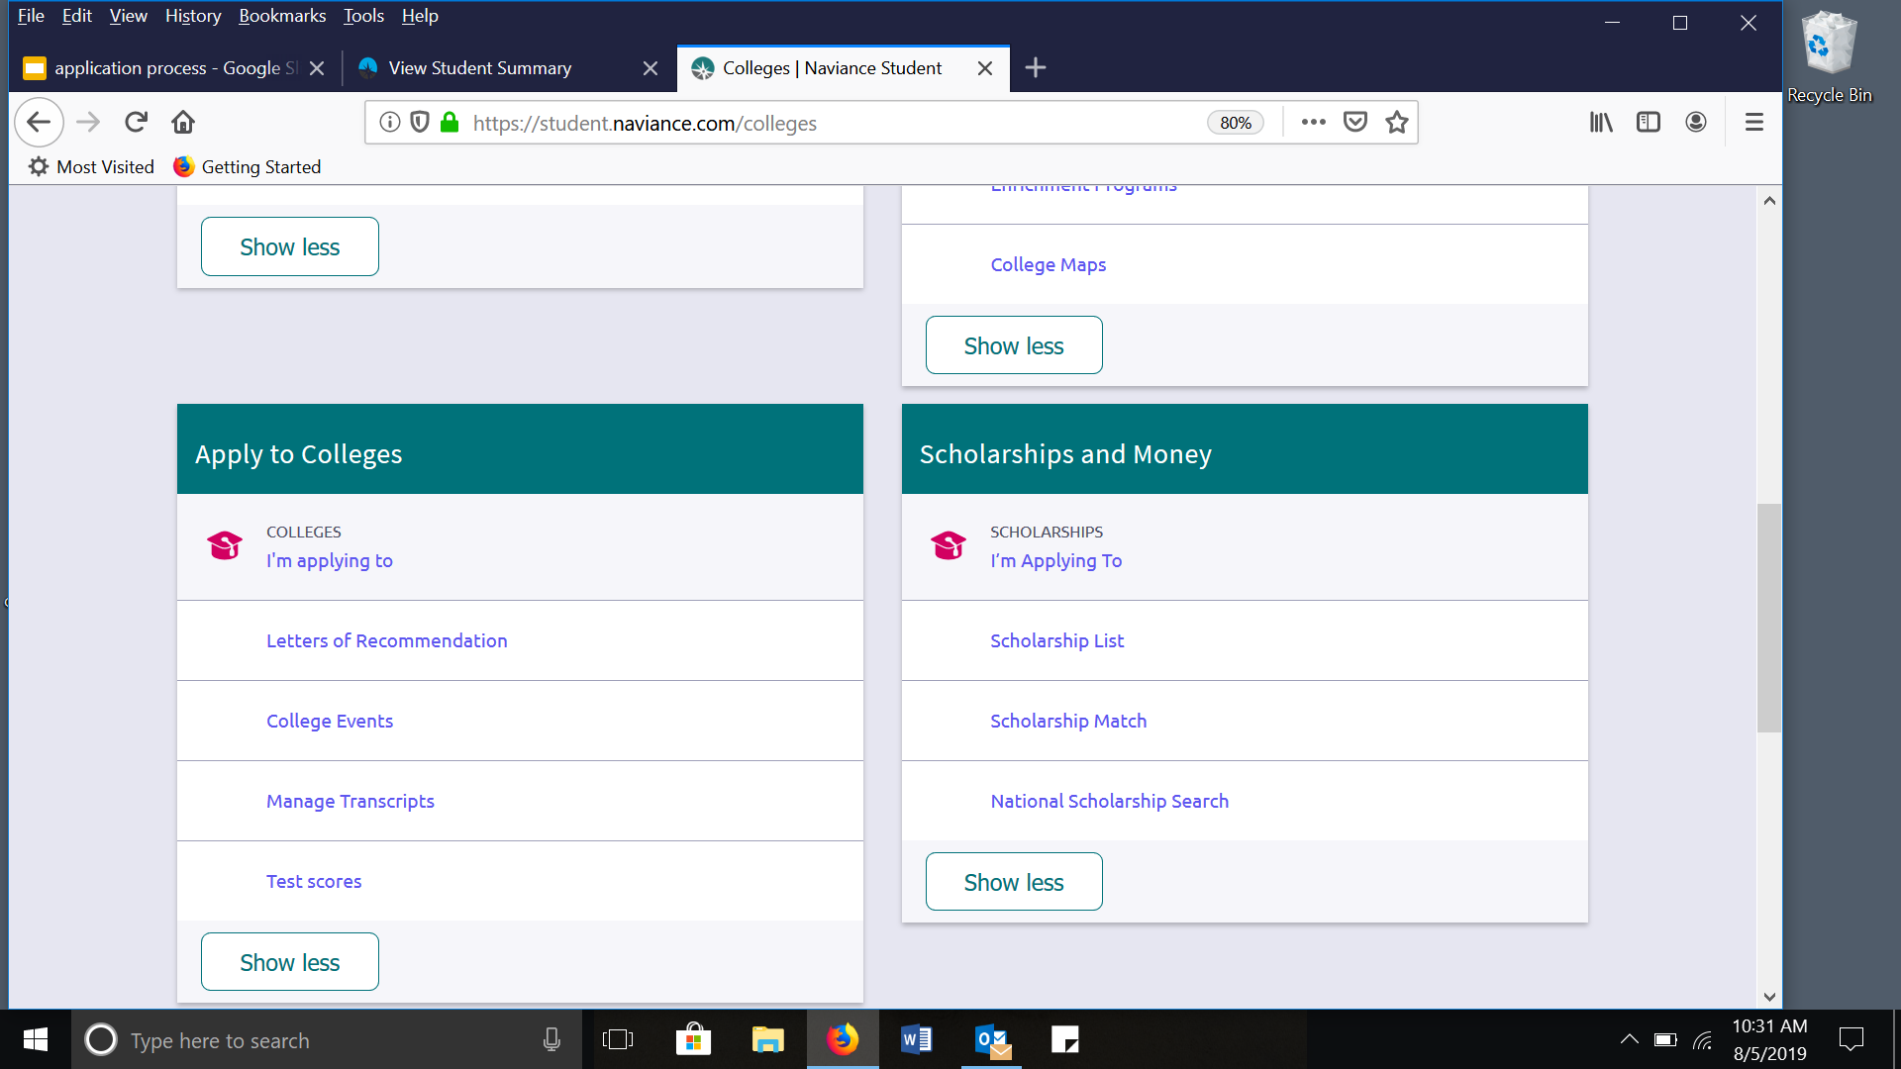
INVITING TEACHERS ON NAVIANCE

Slide 12
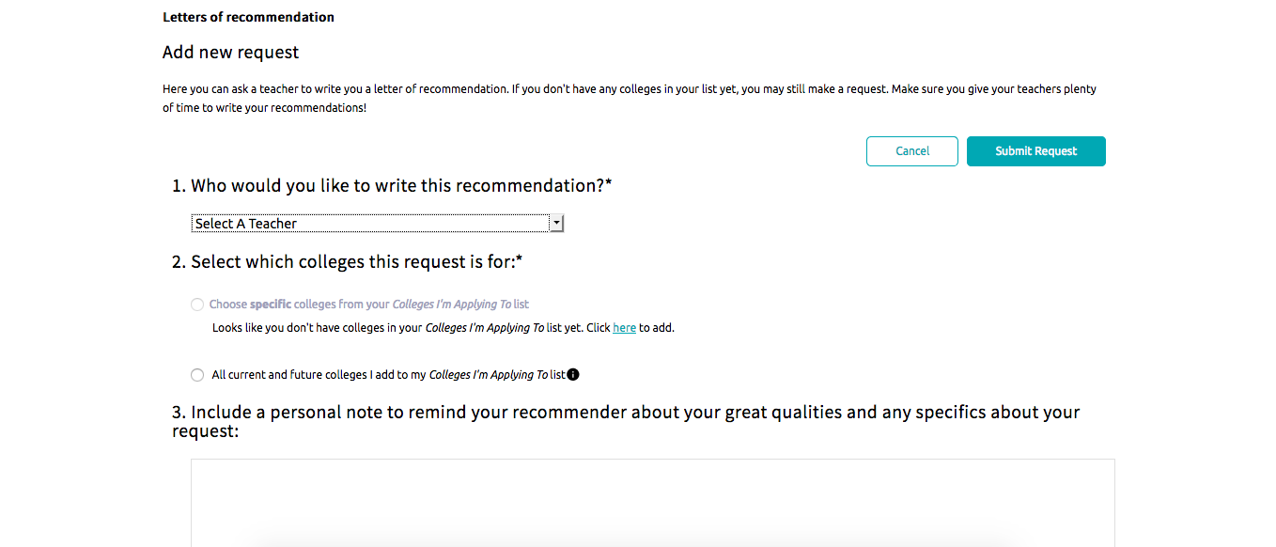
INVITING TEACHERS ON NAVIANCE, CONT

Slide 13
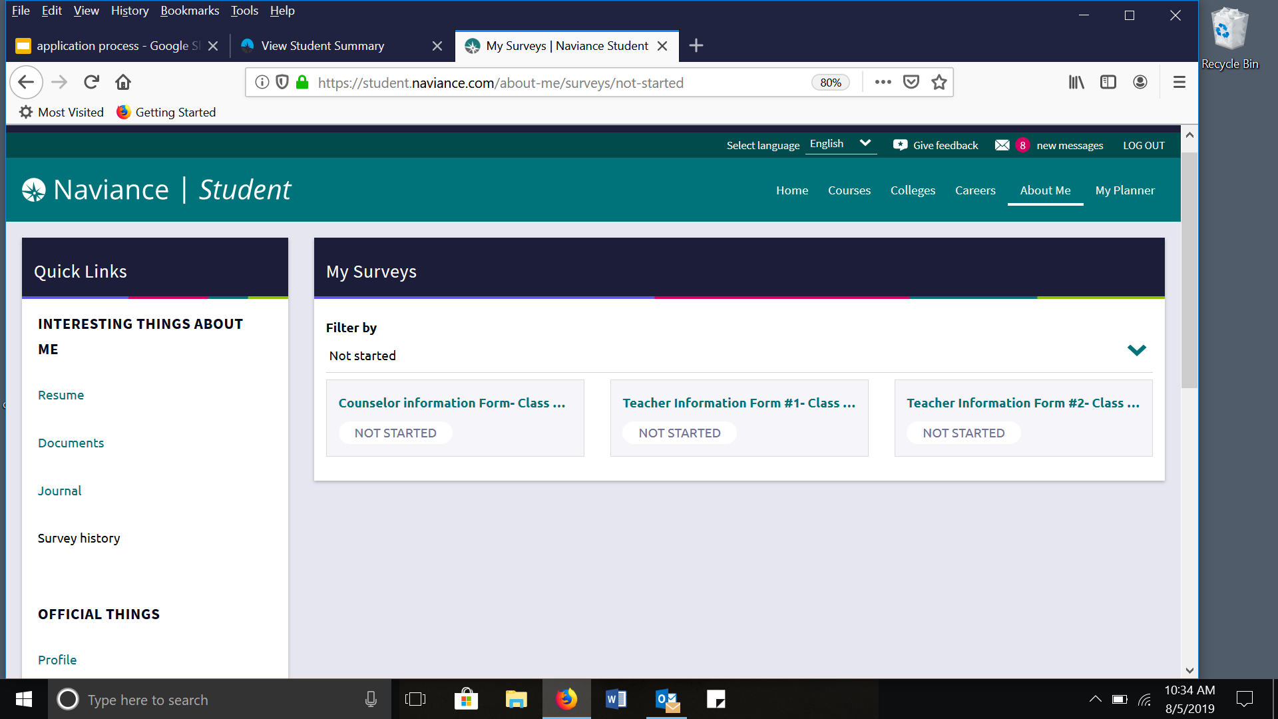
Please answer with
great DETAIL!!

Slide 14
Complete & return to each of your teachers
by October 2 for Nov 1 deadline

Slide 15
SUGGESTIONS FROM TEACHERS
Be sure you are including what you want written in the recommendation in your teacher input form. This is your opportunity to diversify your application.
Be thoughtful of who you are asking to write your recommendation.
A thank you note is appreciated.
Let the teachers know where you got accepted!

Slide 16
OTHER THINGS TO CONSIDER
COMMON APPLICATION AND COALITION
MATCHING NAVIANCE WITH COMMON APP
SAT/ACT
MAKING A LIST
USING NAVIANCE
FINANCIAL AID
UPCOMING DATES

Slide 17
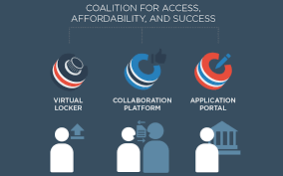

Slide 18
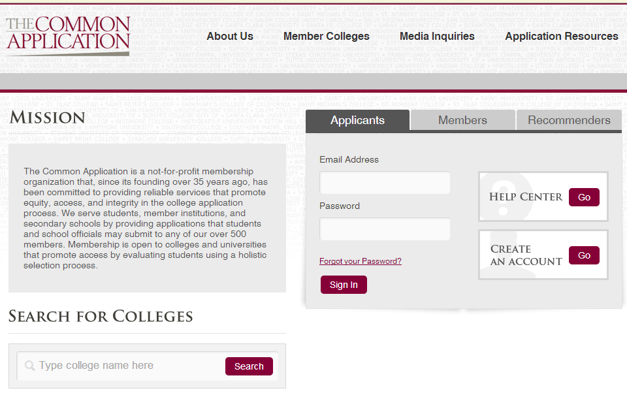
Common Application can be sent to over 500 schools.

Slide 19
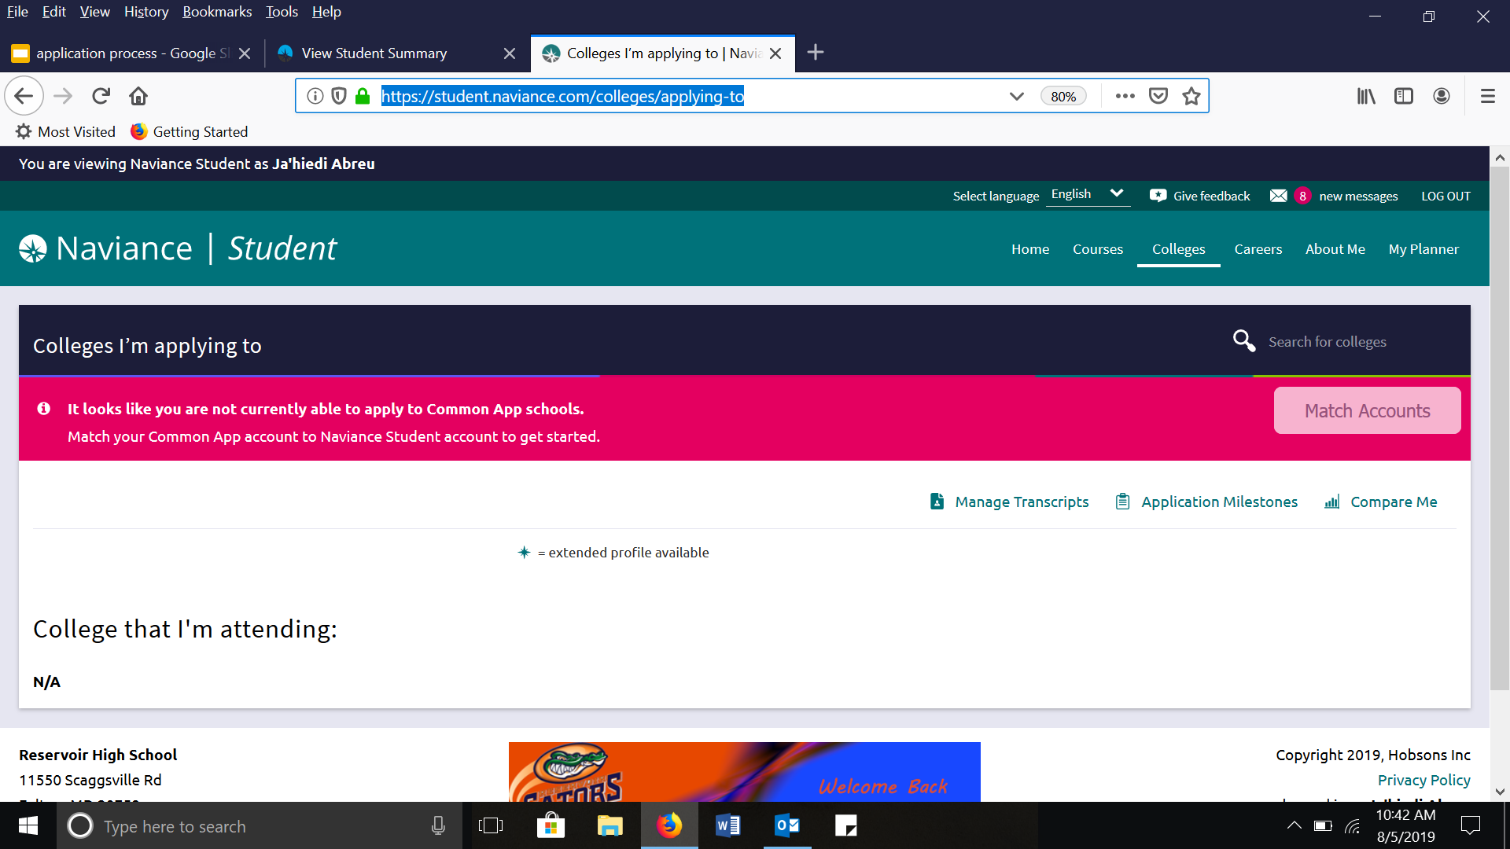
Matching Common App & Naviance

Slide 20
https://www.screencast.com/t/gxEQkElyo1

Slide 21
REGISTER AND STUDY FOR THE SAT/ACT
Register for October 5th SAT
Deadline: September 6th
REgister for October 26th ACT
Deadline: September 20
PTSA Sponsors a SAT/ACT prep class

Slide 22
SAT and ACT RESOURCES
Khan Academy
https://www.khanacademy.org/test-prep/sat
College Board
www.collegeboard.org
ACT
www.act.org

Slide 23
FINANCIAL AID
All students should complete the Free Application for Federal Student Aid.
FAFSA becomes available OCTOBER 1!
Families are to use prior-prior year tax information.
Read, research, ask!
https://studentaid.ed.gov/sa/
https://fafsa.ed.gov/

Slide 24
CREATING A LIST
APPLY TO BETWEEN 5-7 SCHOOLS THAT REPRESENT A STRONG MATCH
ACADEMICALLY
SOCIALLY
FINANCIALLY
GEOGRAPHICALLY
BE OPEN MINDED AND REALISTIC
A SAFE SCHOOL NEEDS TO BE FINANCIALLY SAFE AS WELL

Slide 25
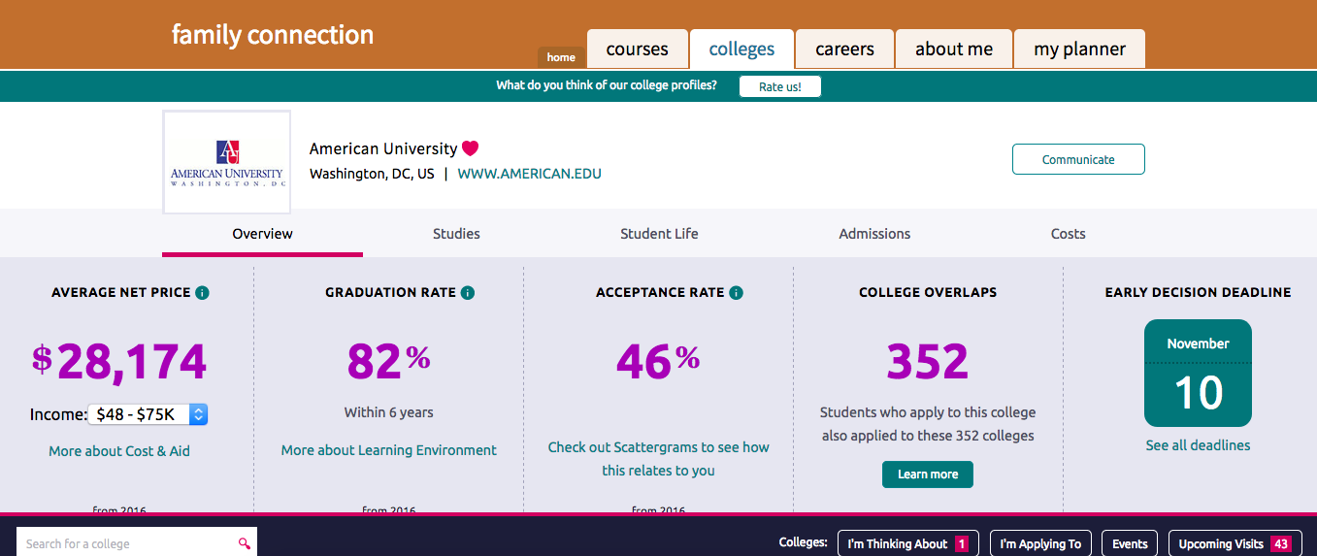
COLLEGE SNAPSHOT

Slide 26
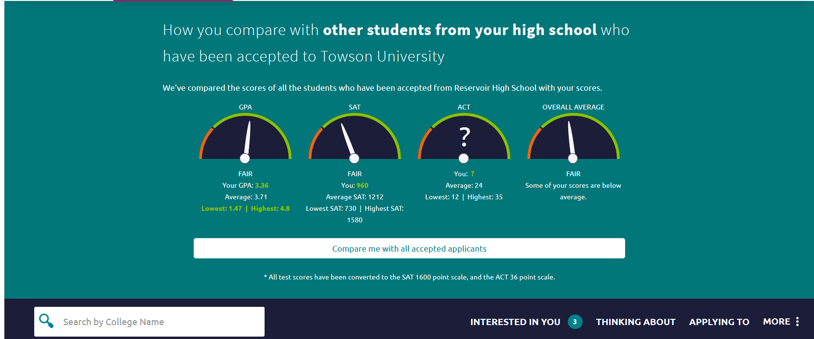
NAVIANCE CAN HELP YOU CREATE A LIST

Slide 27
ADMISSION DECISIONS
Early Decision: Early deadline, early response, BINDING
Early Action Early deadline, early response, NON-BINDING
Single Choice Early Action: Can only apply to one early action
Priority Deadline Students apply by an earlier deadline, and receive priority over students who do not meet the deadline. Decisions are usually given by January 31
Rolling Admissions Students are accepted/denied as applications are received
Regular Admission Apply by regular deadline (usually Jan 15) and
hear a response by April 1

Slide 28
HELPFUL HINTS
Colleges look at your applications as a whole package.
Use different parts of application to highlight different parts of yourself, ie teacher rec, counselor rec, personal essay, short answers
Meet all deadlines.
Utilize all your resources and multiple search engines.
Counselors, teachers, parents, friends, workshops at school, admissions counselors, financial aid counselors
Be realistic when making your list.

Slide 29
ESSENTIAL QUESTIONS
What is the graduation rate of your prospective college?
What is the retention rate of your prospective college?
How does your prospective college meet financial need?
What programs and resources does the college provide to help ensure academic success?
What is the job outlook for your selected major?
How ready and mature am I to attend college?
What is the best decision for me?

Slide 30
TOP RATED WEBSITES!
http://collegecost.ed.gov/
http://www.nacacnet.org/Pages/default.aspx
http://collegerealitycheck.com/en/
https://bigfuture.collegeboard.org/
https://studentaid.ed.gov/sa/
http://www.teenink.com/college_guide/college_essays/

Slide 31
UPCOMING DATES
September 6: SAT Deadline for October SAT
September 9-11 Classroom lessons in English 12 classrooms
September 12-20 Individual senior meetings
September 20 ACT Deadline for october act
September 12: Deadline to request teacher and counselor
recommendations for October 15 deadline
October 2: Deadline to request teacher and counselor recommendations for Nov 1 college deadline
November 1: Deadline for UMCP, UMBC, and early action

